Slide 1
Session 3 Overview
1
This session has 3 main sections:
Bonus Pay – Collect money in virtual environments
Finding the Trophy – Find the trophy as quickly as you can
Questionnaire – Answer some questions about you and your experience in the experiment
Please make sure to listen to each instruction carefully and wait for the experimenter to instruct you to proceed to the next instruction.
Don’t be afraid to ask questions if you need clarification!
Do you have any questions?

Slide 2
Session 3 Overview
2
This session has 3 main sections:
Bonus Pay – Collect money in virtual environments
Finding the Trophy – Find the trophy as quickly as you can
Questionnaire – Answer some questions about you and your experience in the experiment
Please make sure to listen to each instruction carefully and wait for the experimenter to instruct you to proceed to the next instruction.
Don’t be afraid to ask questions if you need clarification!
Do you have any questions?

Slide 3

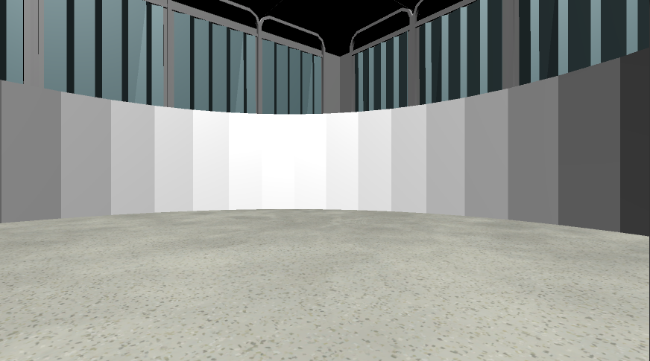
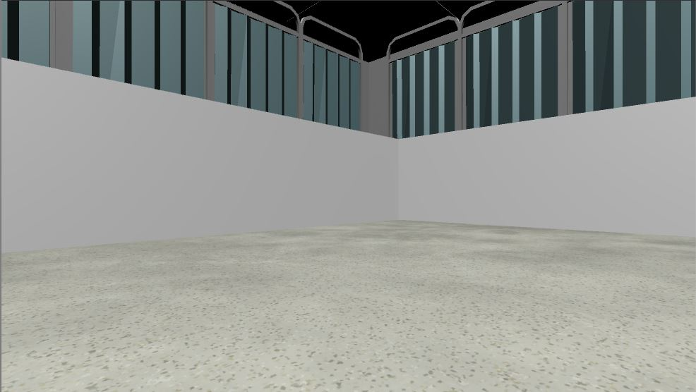

Bonus Pay
Your first task is to collect as much as possible in each of the following Money Collection Rounds. On each round, you will be placed into one of the environments that you learned in the previous sessions. Once in the environment you will have 1-minute to collect as much money as possible!!
1 Minute
Do you have any questions?

Slide 4
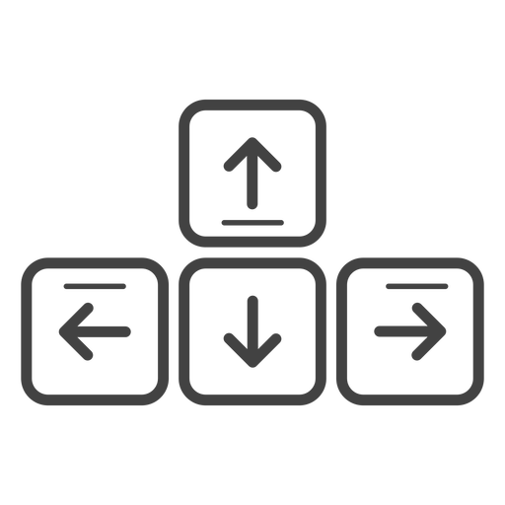
MOVEMENT CONTROLS
The controls are the same as previous sessions: use the Up-Arrow to move forward, and the left and right arrow-keys to rotate.
Move Forward
Rotate
Left
Rotate
Right
Do you have any questions?

Slide 5

MONEY COLLECTION ROUNDS
In this Session ALL rounds are No Feedback Rounds
At the start of every round you will see the “Search For Money! NO FEEDBACK” screen and you will NOT hear a coin sound when you collect money and you will NOT be able to see how much you’ve collected!
Less than 10¢
10¢ or more
Search For Money!
No Feedback Round
Search For Money!
No Feedback Round
Like in the previous sessions, whenever you collect more than 10¢ in a round the money will be added to your Total Bonus Payment. You will only find out your Total Bonus Payment at the end of the experiment.
Do you have any questions?

Slide 6

Hint!
There is an UNLIMITED amount of money to collect in each round so the more you move around in the correct area the more money you will collect!!
Use what you learned in the Previous Sessions to guide your search!
Do you have any questions?

Slide 7

Ready?
When you’re ready, place your right hand on the arrow keys and press the Spacebar with your left to continue!
Spacebar

Slide 8
Great Work!
Notify the Experimenter that you’ve completed this section

Slide 9


Bonus Pay: Environment Variations
In this next section your will be placed into several new variations of the environments you have learned about. On each round, you will be placed into one of the environments that you learned in the previous sessions. Once in the environment you will have 1-minute to collect as much money as possible!!
1 Minute
Do you have any questions?

Slide 10
MONEY COLLECTION ROUNDS
Again, ALL rounds will be No Feedback Rounds
At the start of every round you will see the “Search For Money! NO FEEDBACK” screen and you will NOT hear a coin sound when you collect money and you will NOT be able to see how much you’ve collected!
Less than 10¢
10¢ or more
Search For Money!
No Feedback Round
Search For Money!
No Feedback Round
Like before, whenever you collect more than 10¢ in a round the money will be added to your Total Bonus Payment. You will only find out your Total Bonus Payment at the end of the experiment.
Do you have any questions?

Slide 11
Hint!
There is an UNLIMITED amount of money to collect in each round so the more you move around in the correct area the more money you will collect!!
Use what you learned about the environments to guide your search in the new variations!
Do you have any questions?

Slide 12

Great Work!! You earned $5 in Bonus pay!
PLEASE NOTIFY THE EXPERIMENTER

Slide 13
You’ve completed the Bonus Pay section! Let’s move on to the Find the Trophy Section
Bonus Pay
Find The Trophy
Survey

Slide 15
NO FEEDBACK ROUNDS
Unlike previous sessions, ALL rounds in this session are NO FEEDBACK rounds!
At the start of every round “Search For Money! NO FEEDBACK” screen.
During these rounds you will NOT hear a coin sound when you collect money and you will NOT be able to see how much you’ve collected!
Less than 10¢
10¢ or more
Search For Money!
No Feedback Round
Search For Money!
No Feedback Round
When you reach 10¢ the text will not change color and will remain Red. This means that you will not know whether you have collected more than 10¢. However, if you do collect more than 10¢ by the end of the round the money will be added to your Total Bonus Payment.
HINT: Use what you’ve learned from the Feedback Rounds to guide your search!
Do you have any questions?

